Slide 1
We Asked, You Said

Slide 2
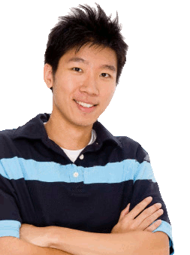
We asked: Tell us some of the things you really like about your school or things that could make it even better.
You said: “My comments have never actually been listened to, but whatever, it was a waste of a perfectly good class, one that I actually enjoy.”
We say: We have a lot of information about how well students are doing in school, but don’t know a lot about how you feel. Your voice is important in improving your learning and in school improvement, and the staff wants you to know that we are listening.

Slide 3
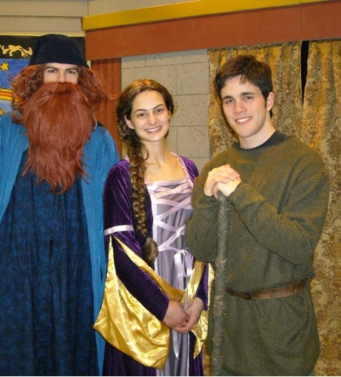
We asked: Tell us about some of the things you would like to see more in your school.
You said: “More presentations and activities to encourage school spirit.”
We say: The staff and school administration appreciate your feedback, and have decided to create a Student-Staff Committee to see what activities students are most interested in. Please listen to daily announcements or check the school’s social media accounts for further details on how to join and/or contribute!

Slide 4
We asked: Tell us about some of the classes taught at your school.
You said: “Christian Ethics, I find we put in time and it does not apply to real life.”
We say: We appreciate your feedback and, at a future Professional Development Day, will focus on how we can work together to deepen students’ understanding of faith in all areas of the curriculum and improve the teaching of Christian Ethics.

Slide 5
We asked: Tell us some of the things you really like about your school or things that could make it even better.
You said: “The parking pass in the student parking lot is a dumb idea.”
We say: The survey helps us understand if changes in school policy make a positive difference for you. The administration reviewed your feedback and will withdraw the parking pass policy.

Slide 6
We asked: Tell us some of the things you really like about your school or things that could make it even better.
You said: “I like this school because it has a lot of clubs, activities and athletics.”
We say: We commit to continue supporting student clubs, activities and athletics by supporting the staff and student organisations that make them possible. Please join us in thanking the teachers, staff, and students that make these activities possible.

