Slide 1

Introducing OurSCHOOL
This section will tell you a little bit about the OurSCHOOL survey and how to complete it.

Slide 2
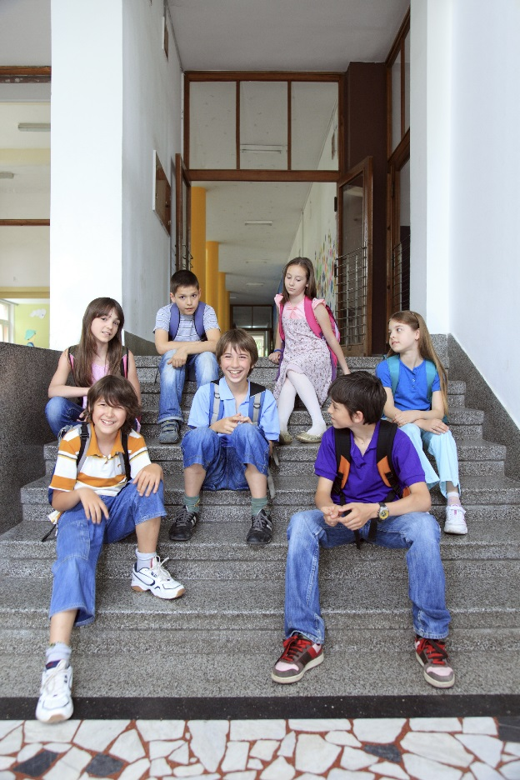
The survey is not a test. Your responses will help your teachers and principal learn more about the school and its students.
The survey is anonymous. No one will know which answers came from you, please be honest.
Do not input any information that would identify you, like your name or your teacher’s name.
Your answers should reflect what you think, not what your friends, parents, or teachers would want you to say.

Slide 3
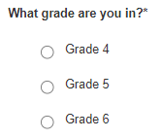
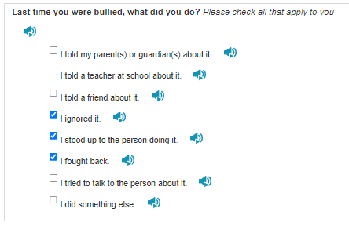
You will complete the survey on a computer, the website is www.ourschool.net
There are two types of questions in the survey:
Multiple Choice: You will see several
possible responses and may only choose one.
Multiple Answer: You will see several possible
responses, and may choose more than one.

Slide 4

Take your time answering each question, you cannot go back to a previous page to change a response.
You can skip any question if you do not know the answer, or do not want to answer.
The progress bar at the top of the screen will increase as you complete the survey. Right now we are at 14% completed, when you are done the survey the number at the center of the progress bar will be at 100% completed.

Slide 5
Survey Topics
This section will review some of the questions you will be asked in the survey.

Slide 6

Family Structure
Which parents or caregivers do you usually live with?
They can be your mom or dad, step-parents, grandparents,
aunts or uncles, or any other adult you live with
        Two parents or caregivers in the same home
    Two parents or caregivers in different homes
    One parent or caregiver
    I live with my parents, and grandparents or other caregivers
    I live in foster care
    Other
You can answer this question on your worksheet.

Slide 7
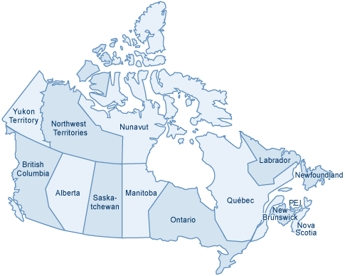
Were you born in Canada?
One survey question asks you if you were
born in Canada.
Places like Manitoba, Ontario, New Brunswick,
and Quebec are all in Canada.
Places like China, Australia, the U.S.A., and
England are not in Canada.
Were you born outside of Canada?

Slide 8

Bullying
Some of the questions on the survey ask about bullying.
Bullying is when a person tries to hurt another person and does it more than once. Bullying can be physical, verbal, or social, and can also take place over the internet with emails or text messages. The bully usually has power over the person being bullied, such as when the bully is bigger or more popular. Sometimes a group of students will bully others.

Slide 9
Sample Questions
This section will show you what the survey questions look like.

Slide 10
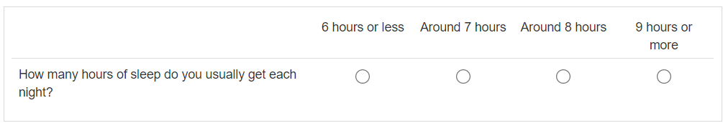
Some questions ask how much time you
spend doing certain activities:

Slide 11
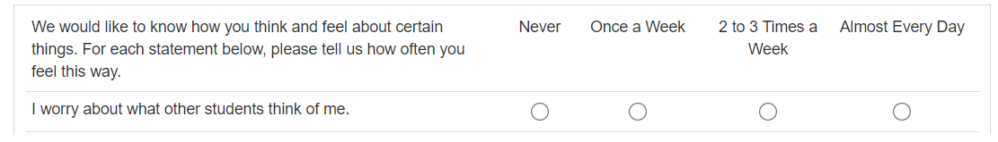
Some questions ask how often you do certain
things or feel a certain way:

Slide 12
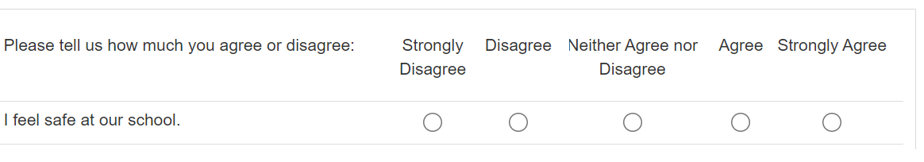
Some questions ask how much you agree or
disagree about certain things:

Slide 13
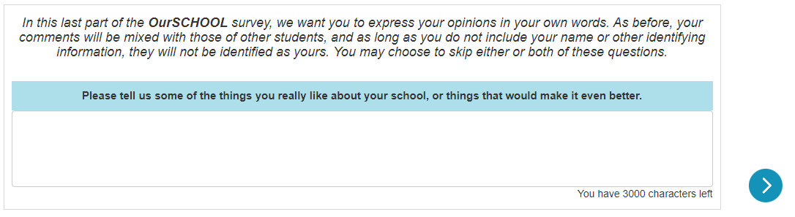
At the end of the survey, you will have a chance to
answer an open ended question. Spelling is not important
here, it is important that your opinion is heard.

Slide 14
Vocabulary
This section explains some of the words used in the survey.

Slide 15

accepted | being liked the way you are; no need to change
confidential, anonymous | secret
encourage | make someone feel good about themselves or what they did, or want to do something better
nervous | worried
statement | sentence; phrase
threat, threaten | someone scaring you by saying they will do something bad

